Slide 1

SPAM SMS CLASSIFICATION Project using Machine Learning
By- Jay Pandey
Internship 32

Slide 2
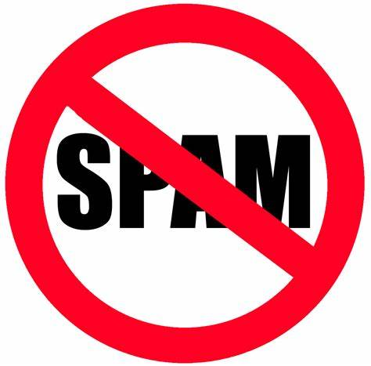
Introduction to Spam SMS Classifier
The spam detection is a big issue in mobile message communication due to which mobile message communication is insecure. In order to tackle this problem, an accurate and precise method is needed to detect the spam in mobile message communication.

Slide 3
Introduction to Spam SMS Classifier
The SMS Spam Collection is a set of SMS tagged messages that have been collected for SMS Spam research. It contains one set of SMS messages in English of 5,574 messages, tagged according being ham (legitimate) or Spam.
Spam Detector is used to detect unwanted, malicious and virus infected texts and helps to separate them from the nonspam texts. It uses a binary type of classification containing the labels such as ‘ham’ (nonspam) and spam. Application of this can be seen in Google Mail (GMAIL) where it segregates the spam emails in order to prevent them from getting into the user’s inbox.

Slide 4
Problem Statement
Our goal of these two parts of article is to show how you could design a spam filtering system from scratch

Slide 5
Sources of data and their formats
A collection of 5573 rows SMS spam messages was manually extracted from the Grumbletext Web site. This is a UK forum in which cell phone users make public claims about SMS spam messages, most of them without reporting the very spam message received. The identification of the text of spam messages in the claims is a very hard and time-consuming task, and it involved carefully scanning hundreds of web pages.

Slide 6
Data Pre-processing
1. ' --', 'null', 'NA', ' ' are not present in the dataset.
2. Drop the unnecessary column from both dataset.
3. calculate the comment length before cleaning.
4. Rename the two final columns as type and massage_body.
5. Encoding type column.
6. Doing NLP steps.

Slide 7
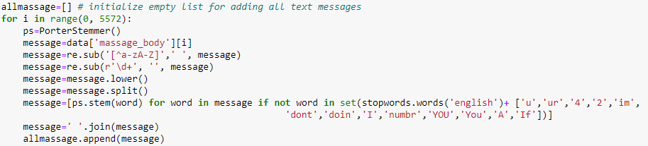
Natural Language Processing:
Import all necessary libraries for NLP. Now let’s remove all alphabates, numbers from the text body. Then apply Stemmer, Stop words and such necessary NLP steps on massage body for cleaning the dataset. We also use Count Vectorizer method on the features and label encoding on target variable.

Slide 8
Exploratory Data Analysis
Let’s start the observation exploration of feature analysis.

Slide 9
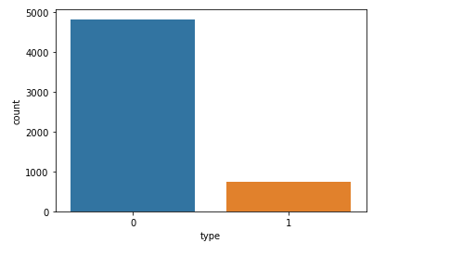
Different feature’s data Distribution
Observations:
Here maximum comments are not spam.

Slide 10
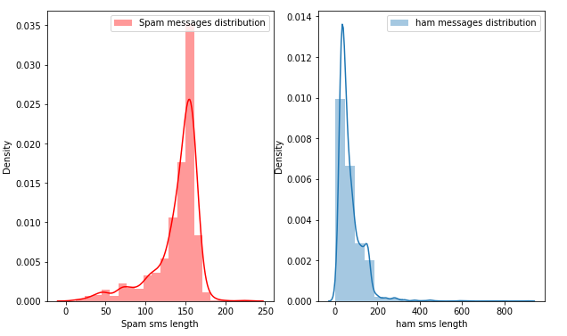
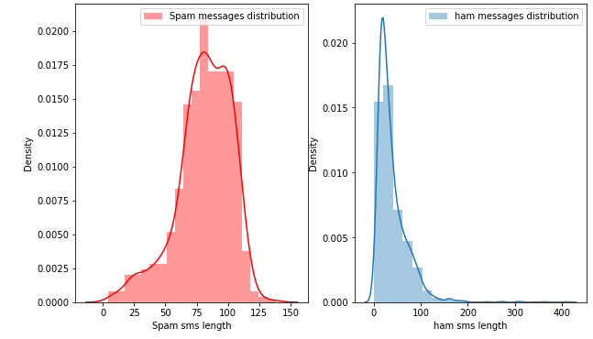
Visualize the comment length for Spam and not spam before clening and after cleaning:

Slide 11
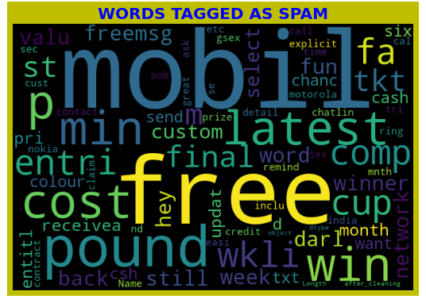
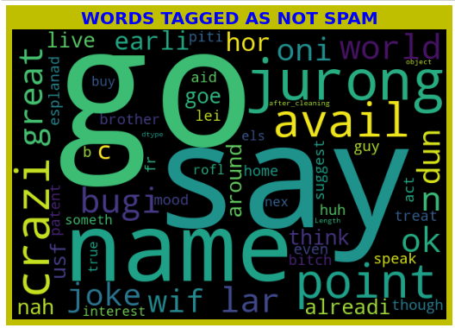
Word Cloud for Spam sms: No such observation is noted from the below images.

Slide 12
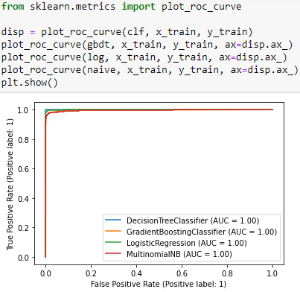
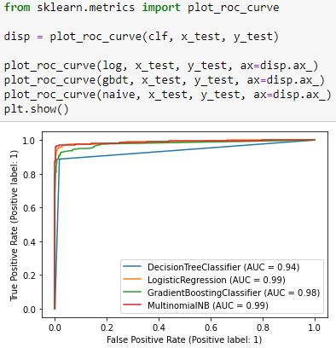
AUC- ROC Curve:

Slide 13
Machine Learning Model Building

Slide 14
Machine Learning Algorithm Used
The different classification algorithm used in this project to build ML model are as below:
Logistic Regression
Decision Tree Classifier
Gradient Boosting Classifier
Multinomial Naïve Bayes Classifier
For final model the target variable is as follows after using Naïve Bayes. For instances, Gmail’s interface is using the algorithm based on machine learning program to keep their users’ inbox free of spam messages.

Slide 15
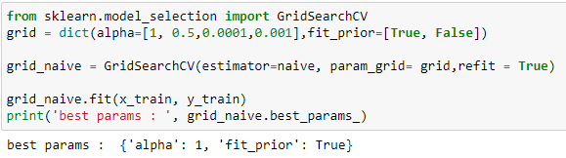
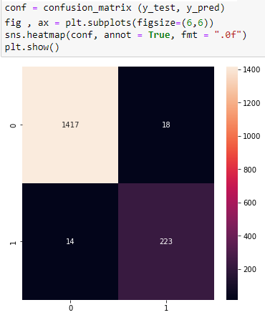
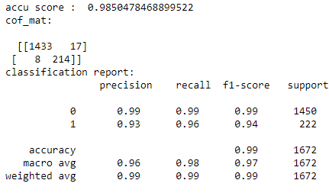
Hyperparameter tuning, Final Model and Confusion Matrix:

Slide 16


